Slide 1
Cloud Computing
The Most Influential Security Risk Management Trend for the Next 5 Years

Slide 2

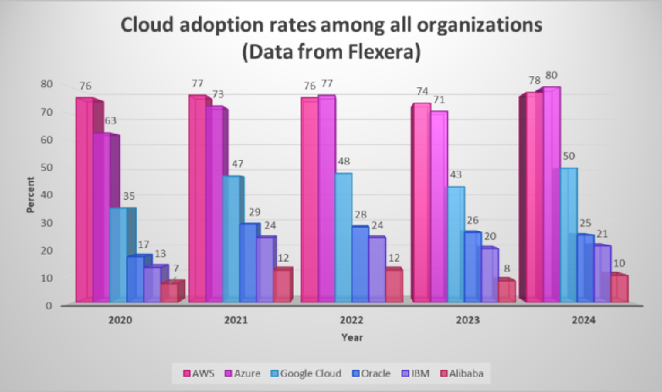




Cloud Adoption & Growth
Companies are increasingly adopting cloud solutions for cost efficiency, scalability, and flexibility.
According to Marston et al. (2011), cloud computing enables businesses to reduce costs while enhancing scalability and flexibility, making it a crucial part of business strategies.
Growth in hybrid and multi-cloud environments drives the trend.
IDC forecasts that by 2025, 80% of enterprises will adopt a hybrid or multi-cloud strategy

Slide 3



Security Challenges in the Cloud
Cloud environments introduce security risks such as data breaches, insecure APIs, and misconfigurations.
Hashizume et al. (2013) identify data breaches and insecure APIs as major vulnerabilities in cloud systems.
Managing compliance with regulations like GDPR and CCPA becomes more challenging in cloud environments.
Rosenthal et al. (2010) emphasize how cloud computing complicates compliance with regulatory frameworks like HIPAA, making security and privacy more difficult to manage.

Slide 4

Emerging Cloud Security Solutions
Technologies like Zero Trust Architecture and Cloud Access Security Brokers (CASBs) are reshaping cloud security.
Shin (2013) discusses the shift toward user-centric cloud service models and the importance of zero-trust security in public sectors.
AI and automation improve cloud security's ability to detect and respond to threats.
Casado & Shenker (2015) explore how software-defined security and automation will lead the next wave of cloud-native security solutions

Slide 5
Why Cloud Computing Will Shape SRM in the Next 5 Years
Cloud computing is now the backbone of digital transformation, making it central to future SRM strategies.
Subashini & Kavitha (2011) highlight how cloud computing has introduced new security challenges and tools that are reshaping the landscape of security risk management.
The growing complexity of cyber threats and reliance on cloud environments will drive future SRM.
The NIST (2020) framework highlights the critical role cloud computing will play in managing risks and improving the security of critical infrastructures.

Slide 6
Bibliography
Marston, S., Li, Z., Bandyopadhyay, S., Zhang, J., & Ghalsasi, A. (2011) Cloud computing—the business perspective. Decision Support Systems, 51(1), 176-189.
IDC Cloud Forecast (2023).
Hashizume, K., Rosado, D. G., Fernandez-Medina, E., & Fernandez, E. B. (2013) *An analysis of security issues for cloud computing.* Journal of Internet Services and Applications, 4(1), 5.
Rosenthal, A., Mork, P., Li, M. H., Stanford, J., Koester, D., & Reynolds, P. (2010) Cloud computing: A new business paradigm for biomedical information sharing. Journal of Biomedical Informatics, 43(2), 342-353.
Shin, D. (2013) User centric cloud service model in public sectors: Policy implications of clud services. Government Information Quarterly, 30(2), 194-203.
Casado, M., & Shenker, S. (2015) Software-defined security. IEEE Security & Privacy, 13(1), 92-95.
Subashini, S., & Kavitha, V. (2011) A survey on security issues in service delivery models of cloud computing. Journal of Network and Computer Applications, 34(1), 1-11.
- NIST (2020) Framework for improving critical infrastructure cybersecurity.
https://www.fierce-network.com/multi-cloud/azure-pulls-ahead-aws-cloud-adoption For image in slide 2

